Slide 1
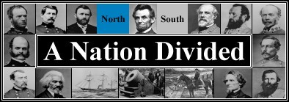
THE AMERICAN CIVIL WAR
1861-1865

Slide 2
Before we begin. . .
Have your atlas ready.
What is a civil war?

Slide 3
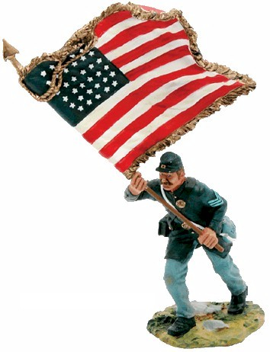
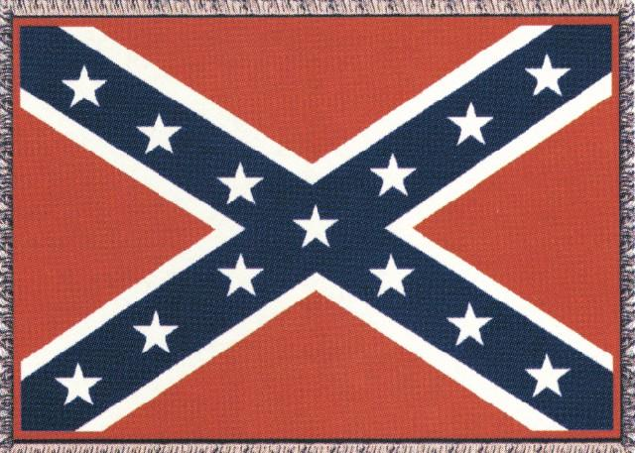
The Civil War: Union vs Confederacy

Slide 4
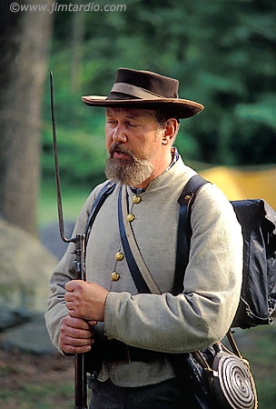
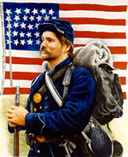
Confederate Union

Slide 5
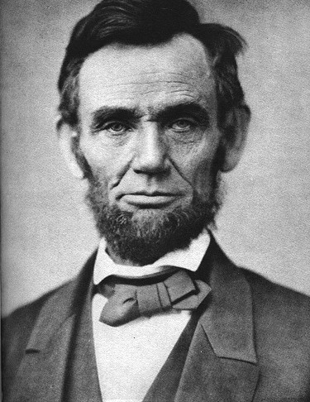
CAUSE #1?
Election of Lincoln
Southern States felt they were bullied by the North when he was elected

Slide 6
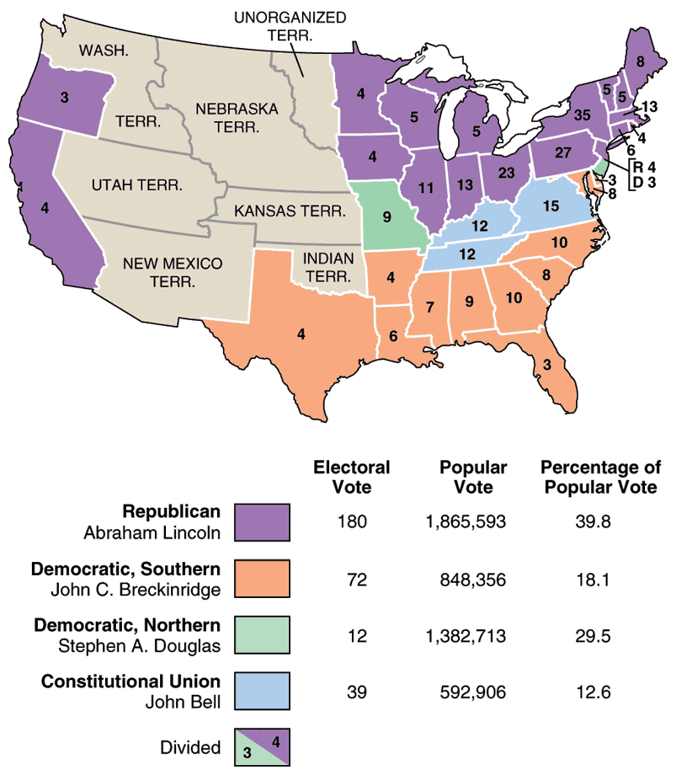
1860
Election
Results

Slide 7
Cause #2
States’ Rights regarding taxation and slavery

Slide 8
Nullification Crisis
Nullify means to ignore
In 1832, South Carolina said they could “nullify” federal law by simply ignoring it.
President Jackson threatened to send federal troops – SC chilled, for now.

Slide 9
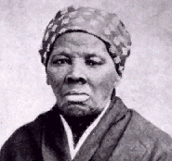
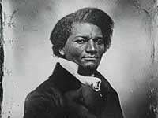
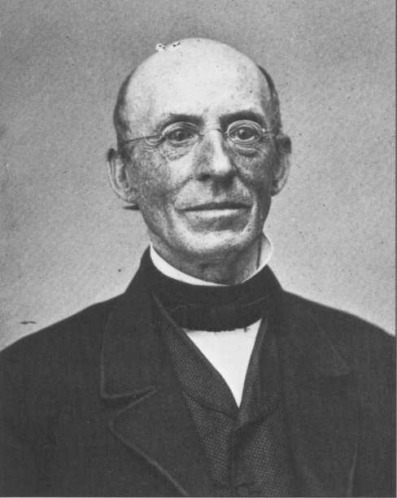
Cause 3:Abolitionism

Slide 10
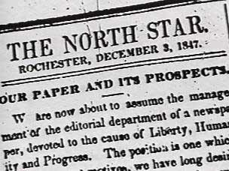
Abolitionists
Frederick Douglas was the editor of an abolitionist newspaper.

Slide 11
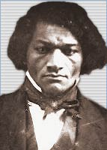
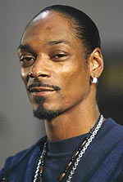
On a side note. . .
Are they related?

Slide 12
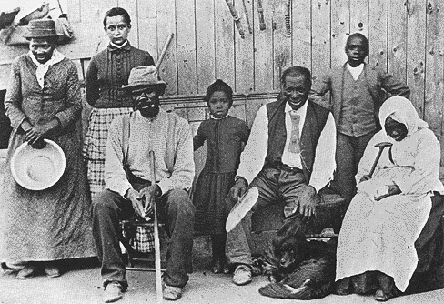
Harriet Tubman
Helped slaves escape via the Underground Railroad.

Slide 13
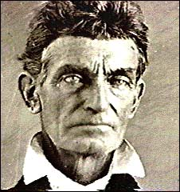
John Brown
He and his sons brutally murdered 5 slave masters in Kansas. (1858)
Tried to incite a slave revolt

Slide 14
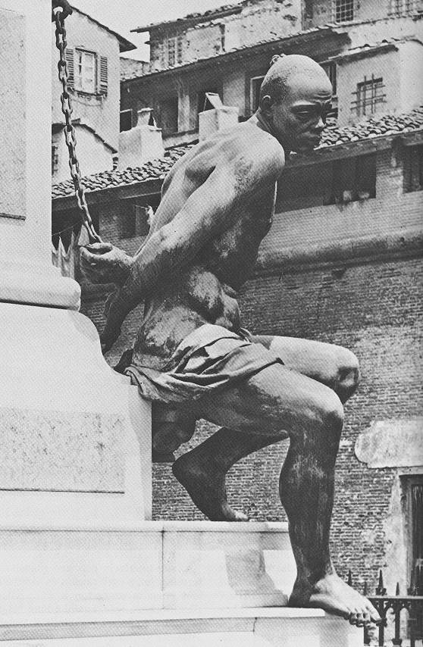
Cause 4: slavery

Slide 15
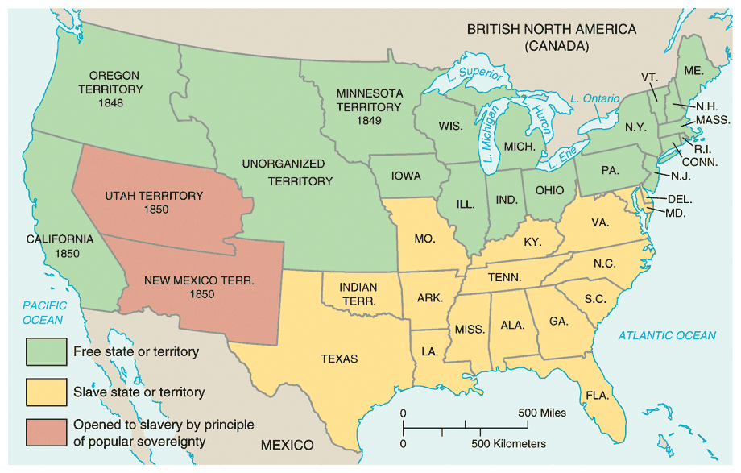
Compromise of 1850

Slide 16
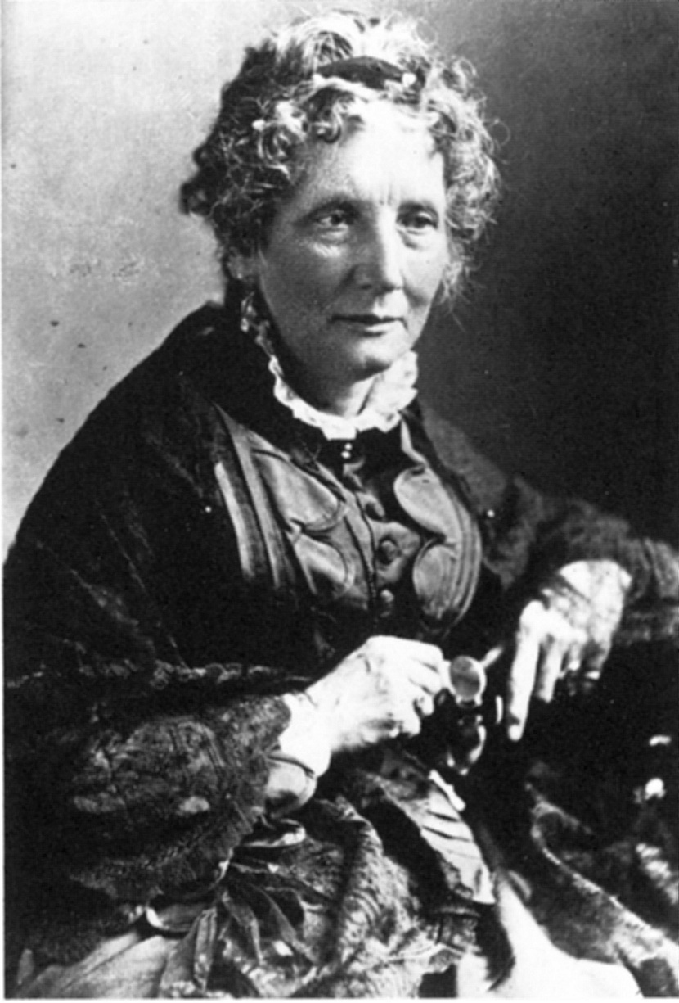
Harriet
Beecher
Stowe
1811 - 1896
So this is the lady who started the Civil War.
-- Abraham Lincoln

Slide 17
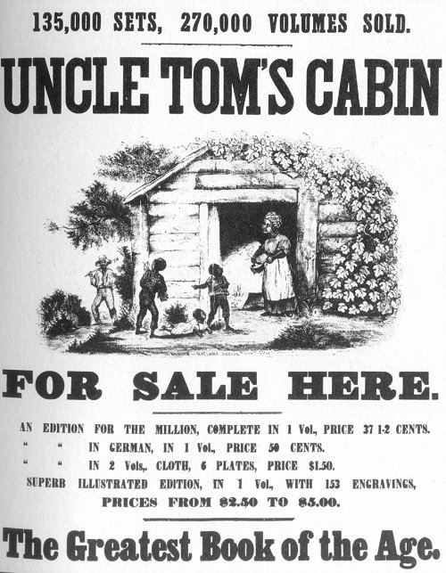
Uncle Tom’s Cabin
1852
Sold 300,000 copies in
the first year.
2 million in a decade!

Slide 18
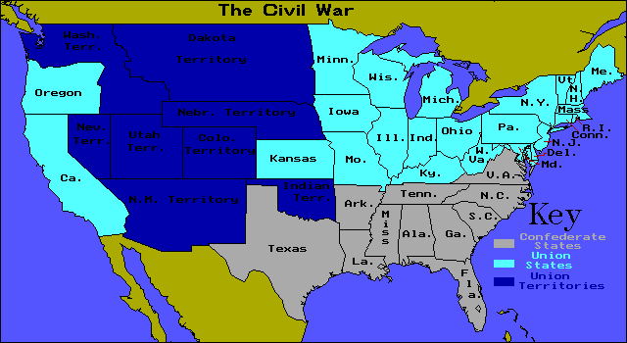
Cause 5: Sectionalism

Slide 19
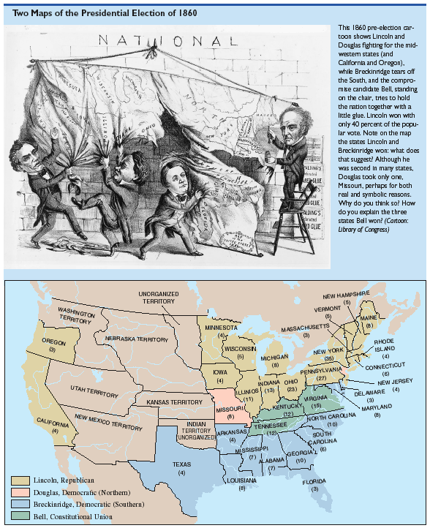
1860 Election: A Nation Coming Apart?!

Slide 20
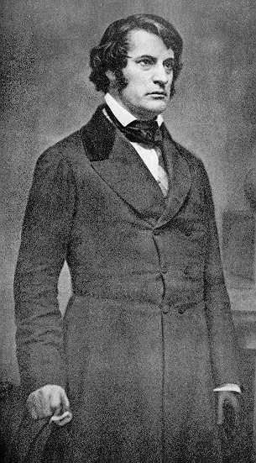
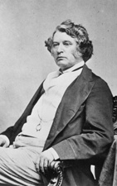
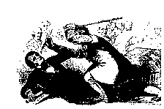
Sectionalism at its worst!
Sen. Charles Sumner
(R-MA)
Congr. Preston Brooks
(D-SC)

Slide 21
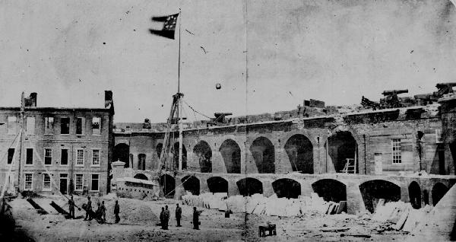
The war begins - the firing on Fort Sumter

Slide 22
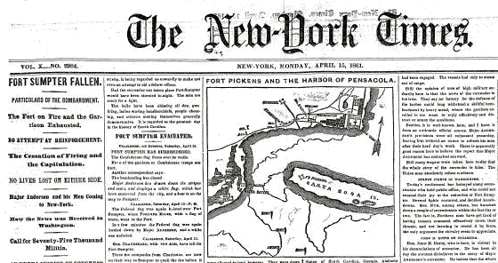
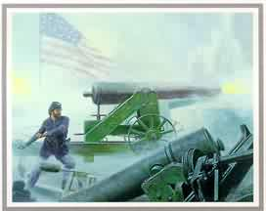
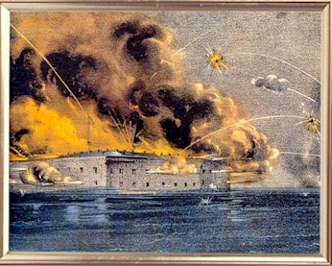
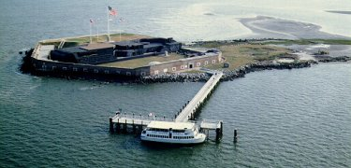
Fort Sumter: April 12, 1861

Slide 23
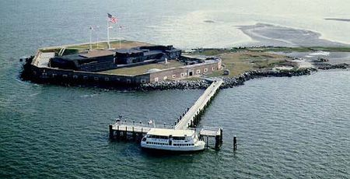
Fort Sumter

Slide 24
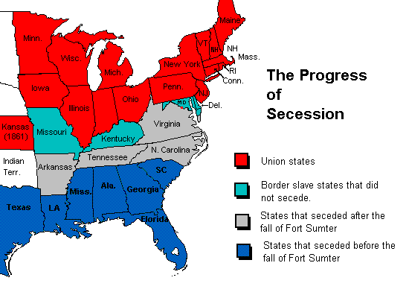

Slide 25
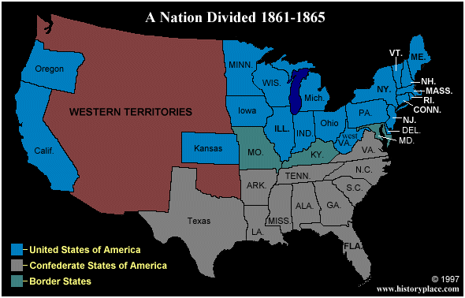
The first States secede

Slide 26
Advantages of the Union (north)?
Union had double the population
Double the railroads
5 times as many factories

Slide 27
Confederate (Rebel) advantages (South)
Confederates had the best generals
Defending is always easier than attacking
Farmers fight better than factory workers

Slide 28
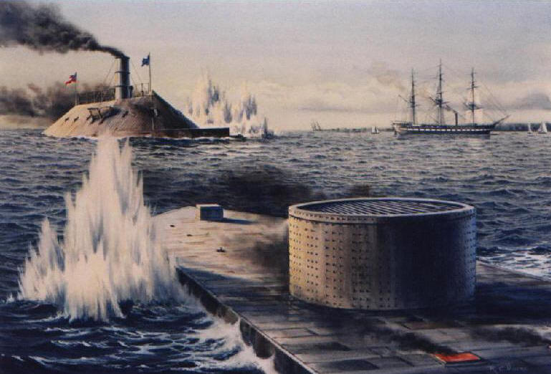
First metal ships in world!

Slide 29
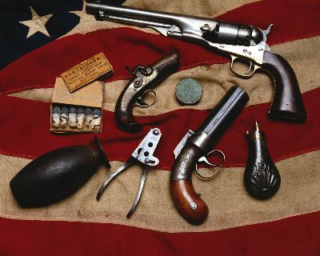

Slide 30
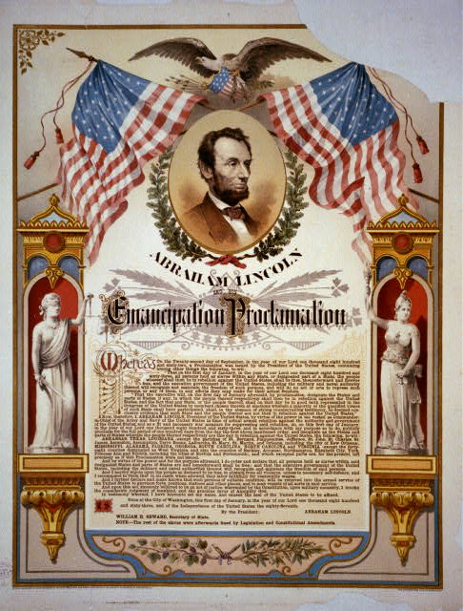
1863

Slide 31
Emancipation Proclamation
It freed the slaves only in states that have seceded from the Union.
It did not free slaves in border states.
1863
Emancipation = freedom

Slide 32
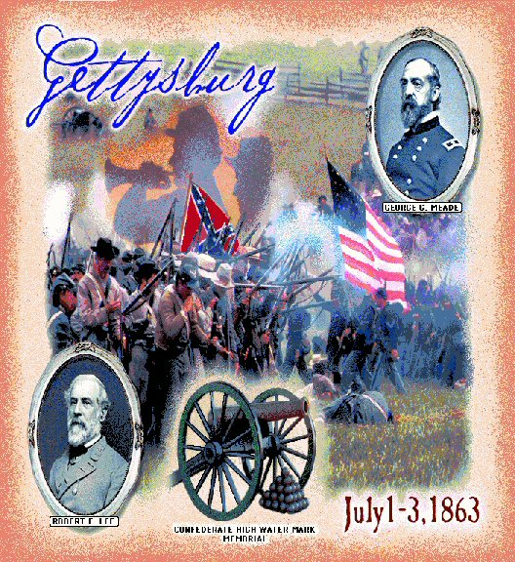

Slide 33
Gettysburg – turning point
Gettysburg is the largest battle in the history of the Western hemisphere.
Over 100, 000 people died in 3 days.
It was the last time the South invaded the North.

Slide 34
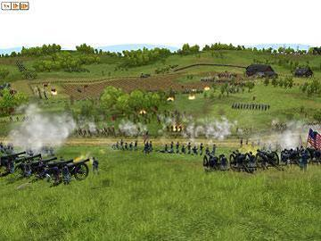

Slide 35
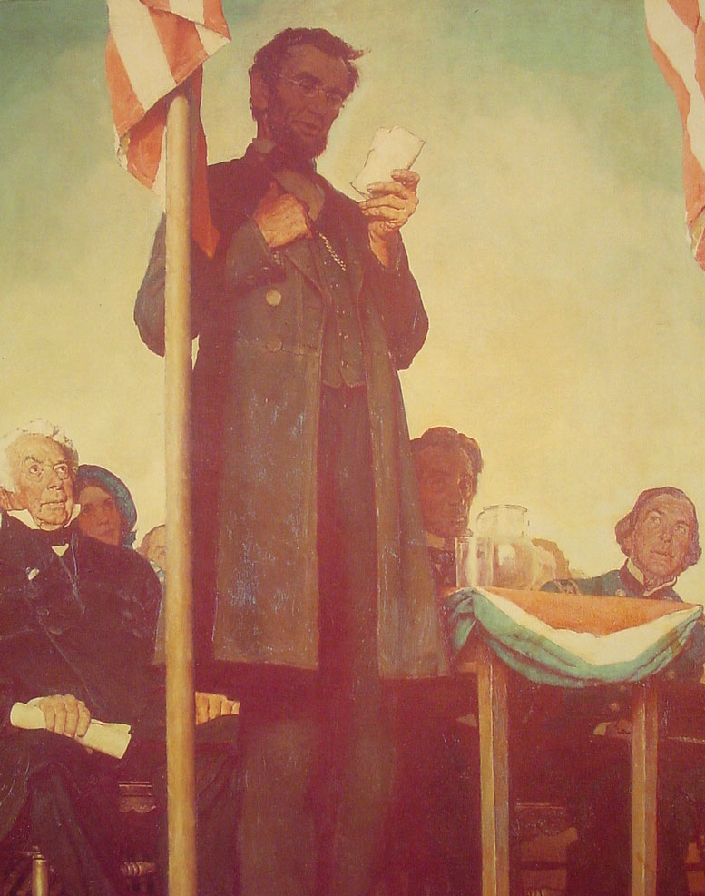

Slide 36
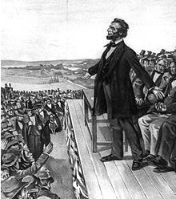
Gettysburg Address
that from these honored dead we take increased devotion to that cause for which they gave the last full measure of devotion -- that we here highly resolve that these dead shall not have died in vain -- that this nation, under God, shall have a new birth of freedom -- and that government of the people, by the people, for the people, shall not perish from the earth.
        Abe Lincoln

Slide 37
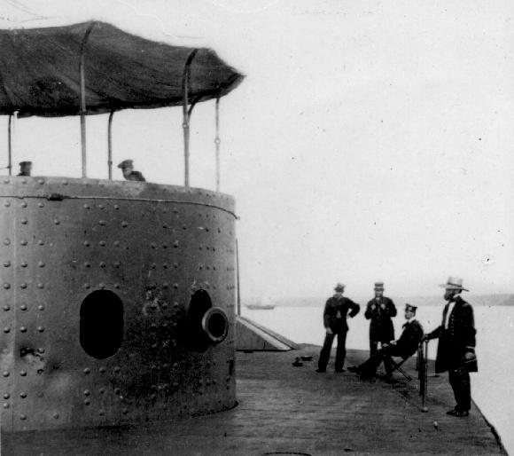
Technology made Civil War . . .
The Monitor

Slide 38
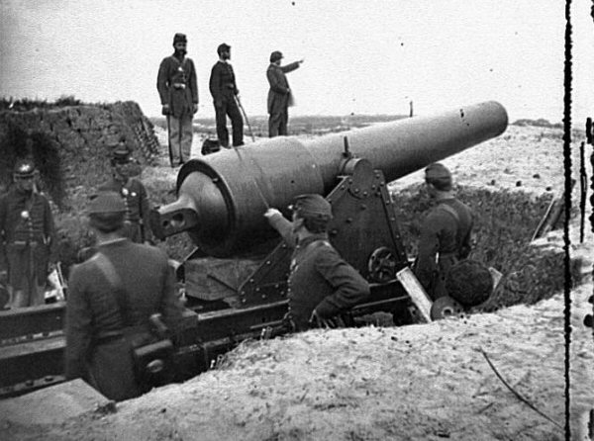
More efficient and deadly

Slide 39
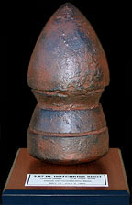
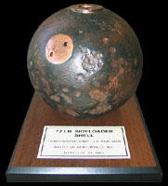
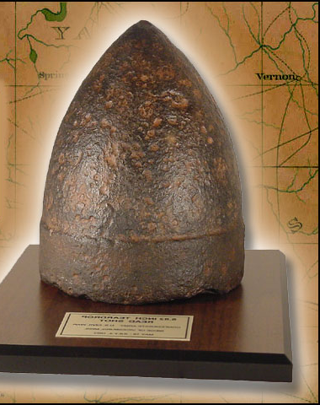

Slide 40
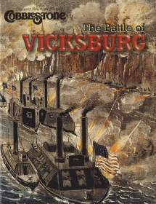

Slide 41
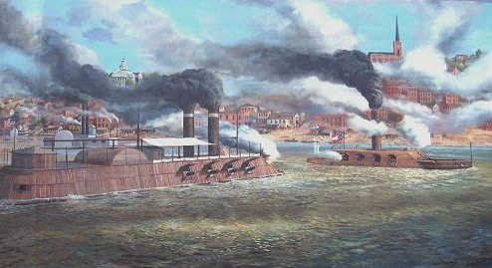

Slide 42
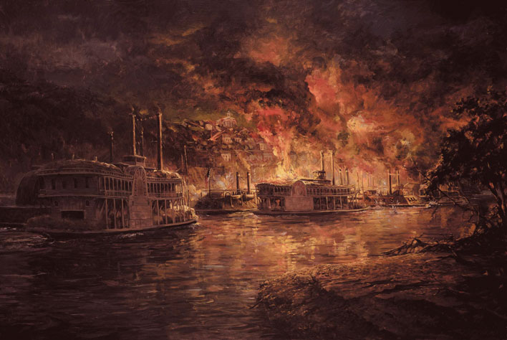
Vicksburg

Slide 43
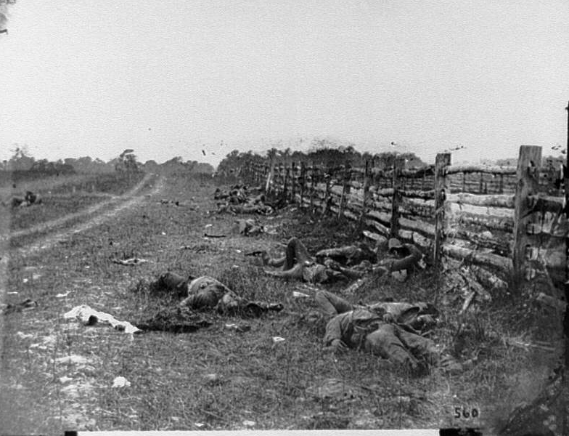
Confederate Dead

Slide 44
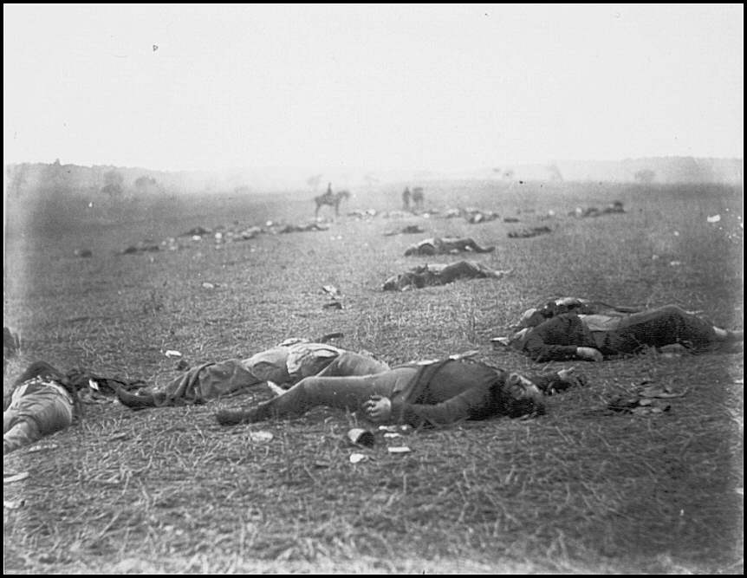

Slide 45
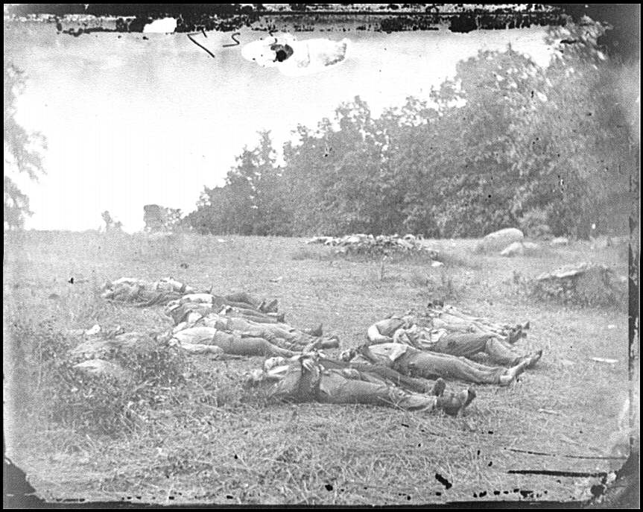
Over 618,000 military deaths during Civil War.

Slide 46


Slide 47

The 54th Regiment attack on Fort Wagner, SC- July 18, 1863

Slide 48


Slide 49

Blacks in the Military
After the Emancipation Proclamation blacks began to join the Union Army
Initially they were only used for manual labor
Eventually, Blacks saw live combat
54th regiment out of Massachusetts
William Carney

Slide 50

After four bloody years of civil war,
the South was defeated.
Notes:
On slide: Graphic.
Click 1: After four bloody years…
Click to next slide.

Slide 51

Civil War ended when Lee surrendered to Grant at APPOMATTOX COURT HOUSE

Slide 52
Results of the Civil War?
Reconstruction – time of rebuilding the country after the Civil War

Slide 53

Reconstruction Amendments
13th Amendment – freed slaves

Slide 54
Reconstruction Amendments
14th Amendment – Everyone born in the US is a citizen, due process of law for all citizens.
15th – Black male suffrage

Slide 55
Remember the Reconstruction Amendments this way:
Free Citizens Vote!

Slide 56

Lincoln is assassinated

Slide 57

Punishment of the killers and conspirators

Slide 58



Questions?

Slide 59
Quiz
1. When was the Civil War?
2. What was 1 cause of the CW?
3. What was another cause of CW?
4. Who was President during CW?
5. Which amendment banned slavery?
6. What was Reconstruction?

